Slide 1

Cyberbullying case study
What it is and how to stop it ?

Slide 2
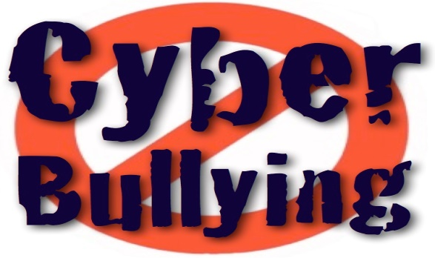
What is Cyberbullying?
Cyberbullying or cyberharassment is a form of bullying or harassment using electronic means. Cyberbullying and cyberharassment are also known as online bullying. It has become increasingly common, especially among teenagers, as the digital sphere has expanded and technology has advanced. Cyberbullying is when someone, typically a teenager, bullies or harasses others on the internet and other digital spaces, particularly on social media sites. Harmful bullying behavior can include posting rumors, threats, sexual remarks, a victims personal information, or pejorative labels.

Slide 3
What are the effects of cyberbullying?
When bullying happens online it can feel as if you’re being attacked everywhere, even inside your own home. It can seem like there’s no
escape. The effects can last a long time and affect a person in many ways:
Mentally — feeling upset, embarrassed, stupid, even angry
Emotionally — feeling ashamed or losing interest in the things you love
Physically — tired (loss of sleep), or experiencing symptoms like stomach aches and headaches
The feeling of being laughed at or harassed by others, can prevent people from speaking up or trying to deal with the problem. In extreme cases, cyberbullying can even lead to people taking their own lives.
Cyberbullying can affect us in many ways. But these can be overcome and people can regain their confidence and health.

Slide 4
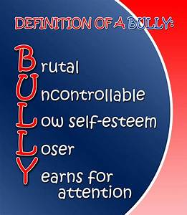
How do we stop cyberbullying without giving up access to the Internet?
Being online has so many benefits. However, like many things in life, it comes with risks that you need to protect against.
If you experience cyberbullying, you may want to delete certain apps or stay offline for a while to give yourself time to recover. But getting off the Internet is not a
long-term solution. You did nothing wrong, so why should you be disadvantaged? It may even send the bullies the wrong signal — encouraging their unacceptable behavior.
We all want cyberbullying to stop, which is one of the reasons reporting cyberbullying is so important. But creating the Internet we want goes beyond calling out bullying. We need to be thoughtful about what we share or say that may hurt others. We need to be kind to one another online and in real life. It's up to all of us

Slide 5
Facebook/Instagram:
Keeping Instagram and Facebook safe and positive places for self-expression is important to us -- people will only be comfortable sharing if they feel safe. But, we know that cyberbullying can get in the way and create negative experiences. That’s why at Instagram and Facebook, we’re committed to leading the fight
against cyberbullying.
We’re doing this in two main ways. First, by using technology to prevent people from experiencing and
seeing bullying. For example, people can turn on a setting that uses artificial intelligence technology to automatically filter and hide bullying comments intended to harass or upset people.
Second, we’re working to encourage positive behavior and interactions by giving people tools to customize
their experience on Facebook and Instagram. Restrict is one tool designed to empower you to discreetly protect your account while still keeping an eye on a bully.
Twitter:
Since hundreds of millions of people share ideas on Twitter, it’s no surprise that we don’t all agree. That’s
one of the benefits because we can all learn from respectful disagreements and discussions.
But sometimes, after you’ve listened to someone for a while, you may not want to hear them anymore. Their right to express themselves doesn’t mean you’re required to listen.

Slide 6
Spotting Cyber Bullies
It is an insidious form of abuse which is usually not taken as seriously as other known forms of abuse, even
though it causes just as much harm to its victims. The internet is a vast place with millions of ways for a bully to hide their identity from the public. With this to their advantage, bullies can say and do anything.
The internet – being virtual – does not show the hurt and pain inflicted in the victims of abuse. Bullies are therefore not always bad people, but given the nature of the internet, they have no way of knowing the actual amount of pain they cause to the person at the other end of the screen. Cyber bullies just type and get up to go on with their lives, leaving the victims of their abuse feeling hurt and unable to move on.
Some victims will even go as far as killing themselves, and since the cyberbully will most likely not be aware of the consequences of their actions, they will keep on bullying and causing even more harm.
There are a lot of videos that show the true ugly side of cyber bullying. College students are especially opinionated and tend to spit out words without any filter, all the while causing pain to someone else.
Two such videos talk about the real world examples of cyber bullying among college students. Students give their testimonials about how they have encountered cyber bullies on the internet and still managed to live through the haunting experience.

Slide 7
Case Study 1: 12-year-old cyber-bully victim commits suicide.
A 12-year-old Florida girl has committed suicide after she was allegedly bullied online by more than a dozen other girls, and a sheriff said Thursday that he is investigating whether he can file charges under a new state law that deals with cyber-bullying.
The case follows several suicides by teens who were bullied through anonymous trolling on social media websites. Sheriff Grady Judd said that Rebecca Ann Sedwick jumped to her death on Monday at an old cement facility in Lakeland, Fla. Investigators said she had been despondent after other girls had posted hateful messages about her online. Sedwick was "absolutely terrorized on social media," Judd said. The Lakeland Ledger reported that detectives found multiple social media applications in which Sedwick was frequently bullied with messages including "Go kill yourself," and "Why are you still alive? "Judd said that the parents of all 15 girls believed to have been involved in the bullying have cooperated with detectives, and that several cellphones and laptops have been confiscated. Hesaid charges including cyber-stalking -- could be filed. "If we can get any evidence of a criminal offense, the person or persons involved will be punished," he said. Students and parents from Sedwick's school said bullying is a problem, local news reported.
Other students complained that reporting bullying earns them the title of "snitch" among fellow students, and that school authorities have ignored their concerns.

Slide 8
Warning signs about the case:
Local media also reported that Sedwick's mother had complained to school officials and had filed a bullying report with the district before her daughter's death.
Before her death, Sedwick had searched questions online related to suicide, including "How many over-the-counter drugs do you take to die?" and "How many Advil do you have to take to die?"Judd said a 12-year-old boy in North Carolina, whom Sedwick met through social media, had knownof her plan.
Sedwick messaged him only hours before her death, saying she was dead and "I'mjumping, I can't take it anymore. "Judd said that detectives are trying to investigate the social media applications that Sedwick might have used, but that some of them are based in other countries.
"If you bully somebody online and it's reported to us and we can build a credible case, we will
charge you," he said.

Slide 9
Case study 2: Mother discovered her daughter hanging in a closet.
On October 16, 2006, a mother discovered her daughter hanging in a closet. The victim was 13-year old Megan Meier. (ABC NEWS) Months before her death, Megan had shown signs of depression. Megan had low self-esteem, but she was happy to get a friend request from a 16-year old boy on MySpace. She began talking to the boy, who claimed to be homeschooled. Soon, the compliments turned to cyber-bulling as Megan was called “fat” and a “slut”.(ABC NEWS) A few weeks after Megan’s death, the family found out that the boy that Megan had been talking to was really a neighborhood mother who had created the page to bully Megan. The mother has not been charged with any crime, and the Meiers are still seeking justice in this case. (ABC NEWS) They have started the Megan Meier Foundation. The mission statement of the foundation is to help raise awareness about bullying and cyber-bullying in children’s daily environment.

Slide 10
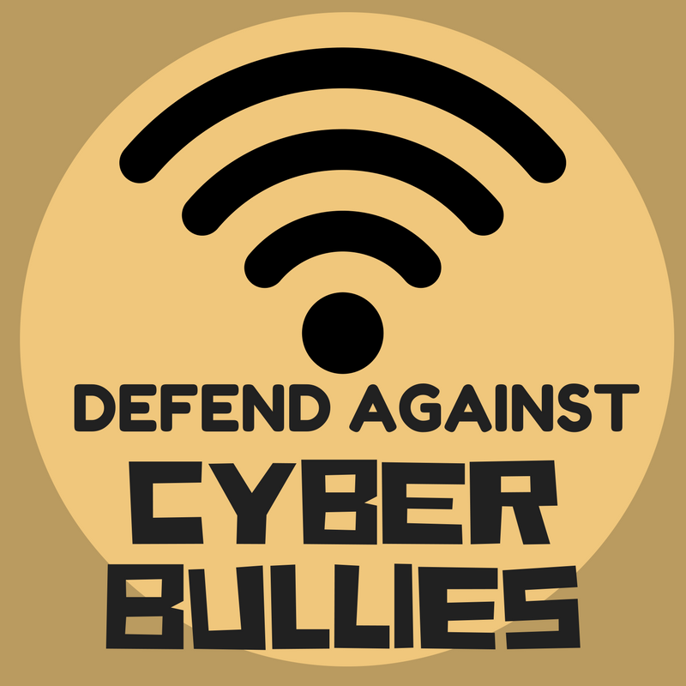
Conclusion:
Cyber bullying, if no steps are taken against this, can create a huge problem on the Internet. Lawmakers should discuss with the psychiatrists to make law against cyber
bullying because bullying causes a huge me not only cyber bullying, there are many other
cyber crimes happening all over the country which needs separate laws.
If laws are not made soon the victims will have to suffer more. But as we all know precautions are better than cure the students needs to be more aware and needs to use Internet positively, they need to take security measures on their social media profiles.
mental pressures among children and mostly children are the victims.

Slide 11
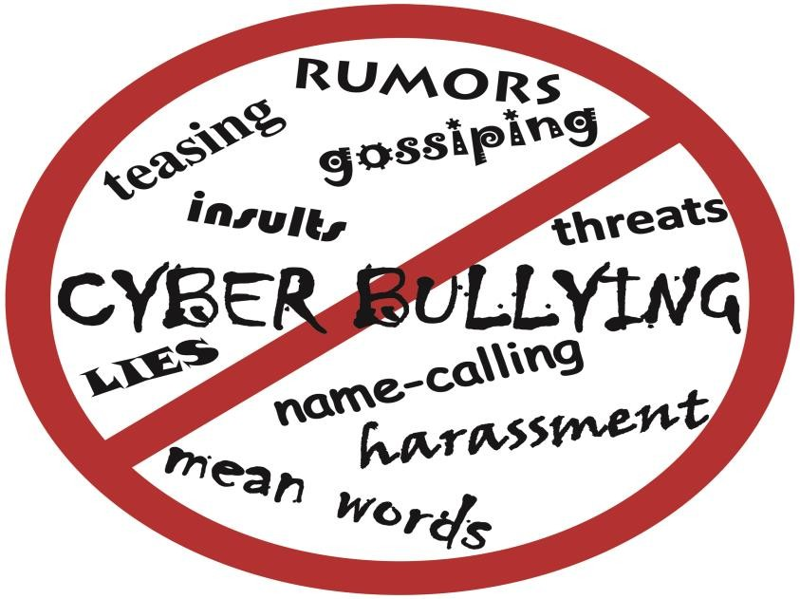
Statistics:
In the past year, 16% of high school students were electronically bullied. However, Cyber-bullying is not just an epidemic for older teenagers.6% of students in grades 6-12 experienced cyber-bullying as well.

Slide 12


